Slide 1

How to thrive in a post Zombie-Apocalyptic world
U of O Data Analytics Bootcamp
November 2020
Danica Tiegs, Lauren Gardner,
Siara Leninger, Stacey Wai

Slide 2
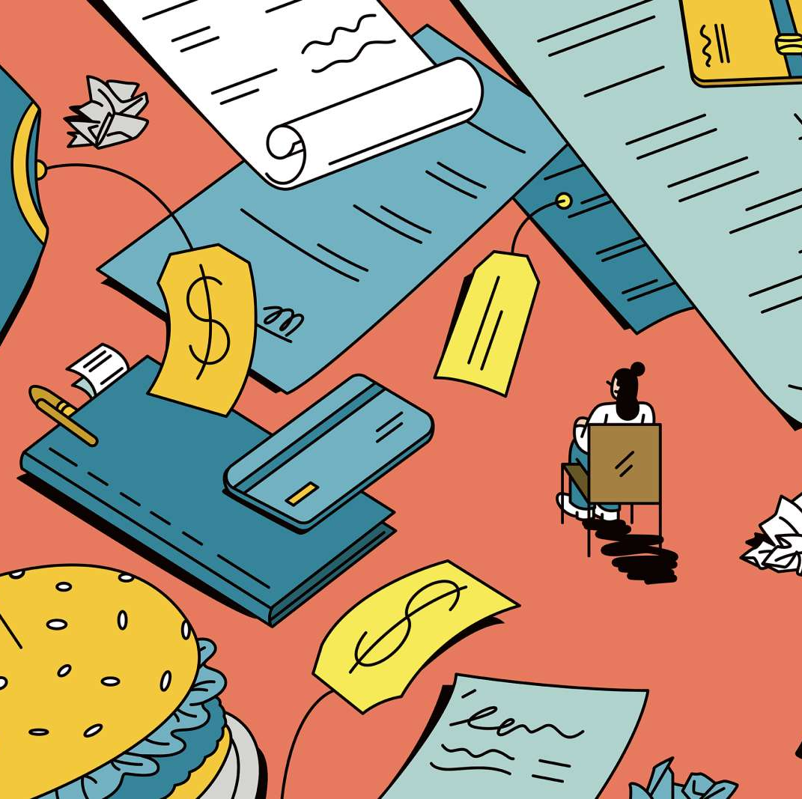
What items are necessary for survival?
Hypothesis: When the world is faced with fear and panic, certain items will unexpectedly become household necessities
How does spending correlate to a pandemic?
Expected trends v unexpected trends
Does spending change after a ”new normal” is established?
If we are faced with a second Apocalypse, what items should I have on hand?
Notes:
Stacey:
Hypothesis -

Slide 3
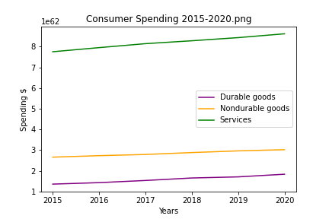
How we spent our money the past 5 years..
Data sourced from BEA (US Bureau of Economic Analysis) official PCE report
Notes:
Stacey & Danica
Danica – how we chose the data and cleansed data
Stacey:
Hypothesis -
Over the past 5 years we saw categories grew at ave rate of :
Durable goods: 6.24%
Nondurable: 2.58%
Services: 2.14%

Slide 4
Spending in the midst of panic and fear…
Notes:
Stacey

Slide 5
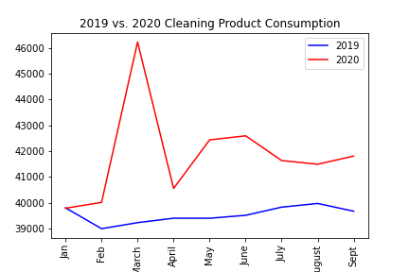
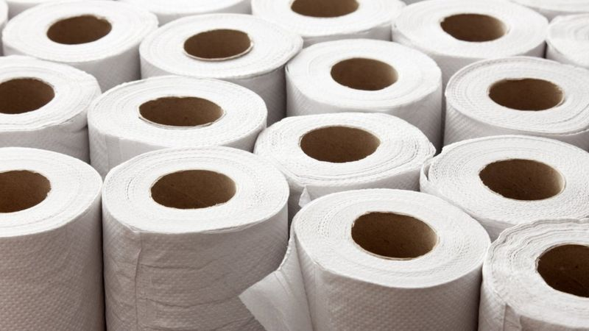
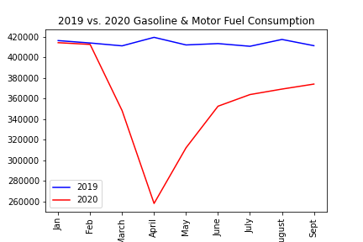
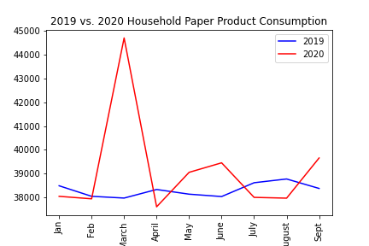
Panic Spending
Notes:
Danica
Non-durable
Prescription & non-prescription drugs
Cleaning supplies

Slide 6
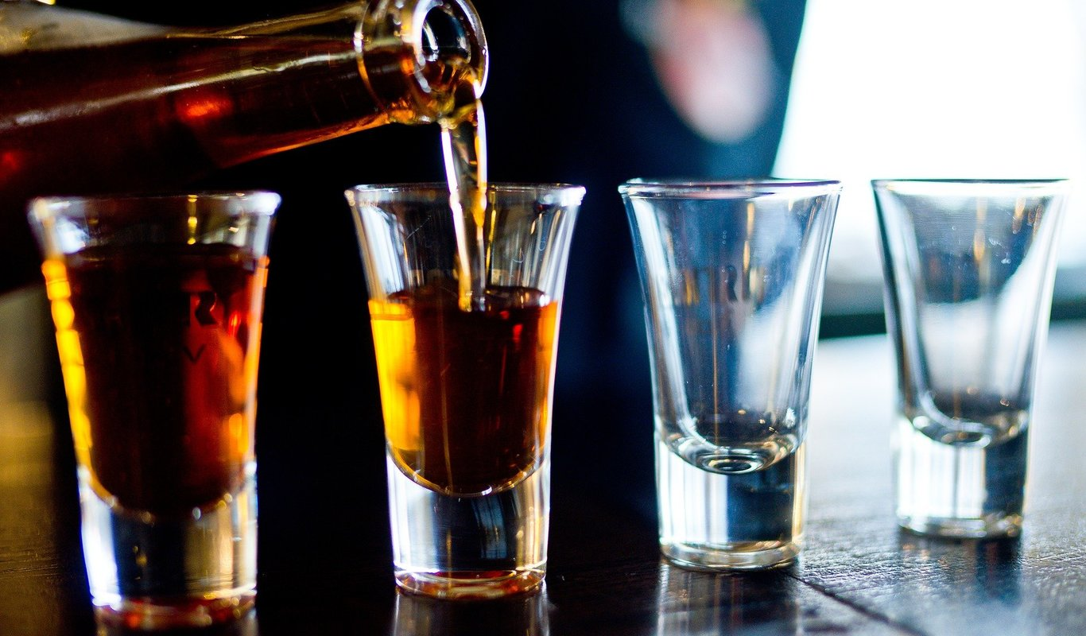
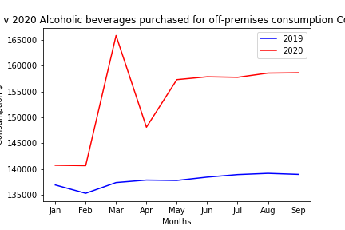
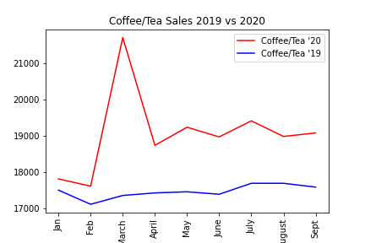
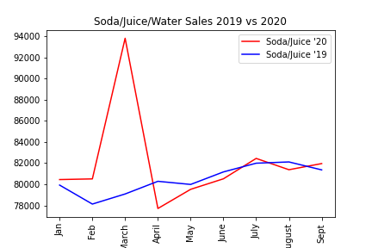
When in panic…always drink more
Notes:
Lauren

Slide 7
Adjusting to a new normal…
Notes:
Lauren

Slide 8

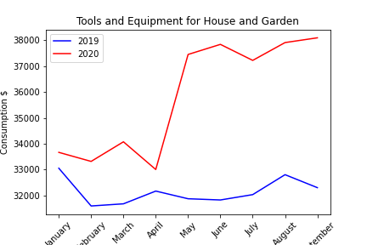
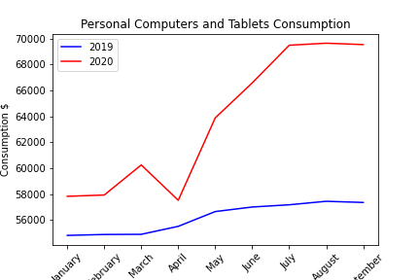
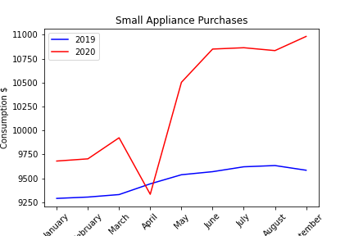
Being productive in a new world
Notes:
Siara

Slide 9
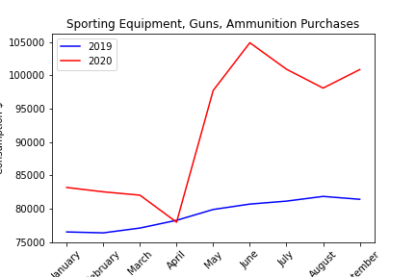
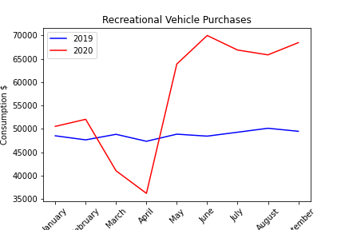
New ways to socialize
Notes:
Siara
Not part of the initial spike but items we saw an increase in post new-normal
recreational vehicles
Small appliance
Sporting eq, guns and ammunition
Gardening
Personal computers

Slide 10
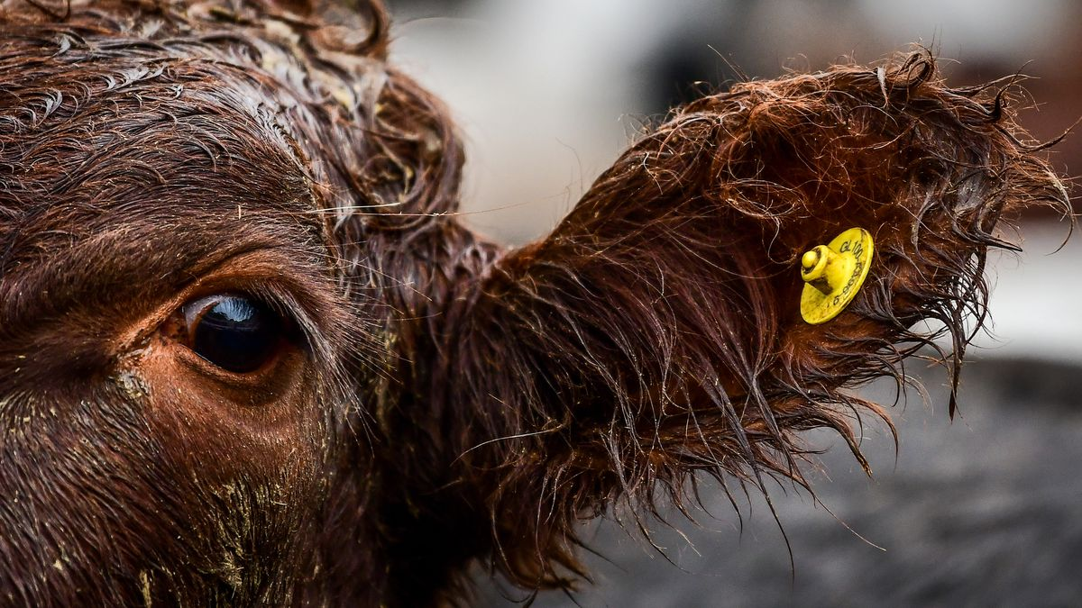
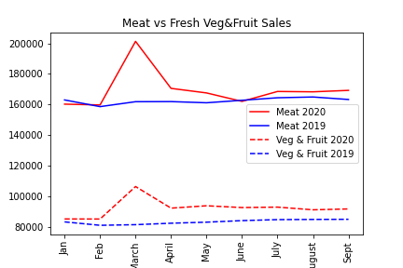
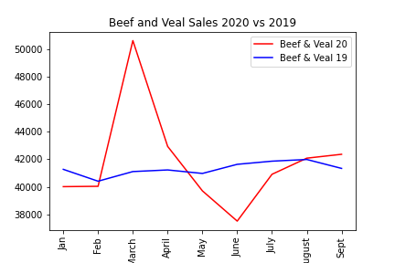
Meat Trends
Notes:
Lauren

Slide 11
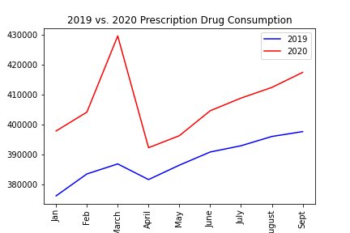
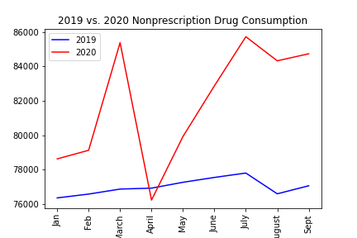
Unexpected Trends
Notes:
Danica

Slide 12
Challenges Faced
Data cleansing the data output from BEA, created smaller subsets within Excel first then imported to Pandas
Large dataset with vague category descriptions making it difficult to understand data and find trends
Narrowing scope
Tieing our findings together cohesively
Notes:
Stacey

Slide 13
Final recommendation/conclusion
How to prepare for an apocalypse
How to thrive in a post apocalypse economy
Notes:
Lauren
Conclusions – how to prepare for for an apocalypse (what items to have on hand) and then how to thrive post apocalypse economy
Mention items to barter

